Slide 1

Paper - 403
Ms. P.olynia V. Kharbuli
Dept. of Computer Sc.
St. Anthony’s College, Shillong

Slide 2

It was developed in the 1977 by
Larry Ellison
Ed Oates, &
Bob Miner

Slide 3
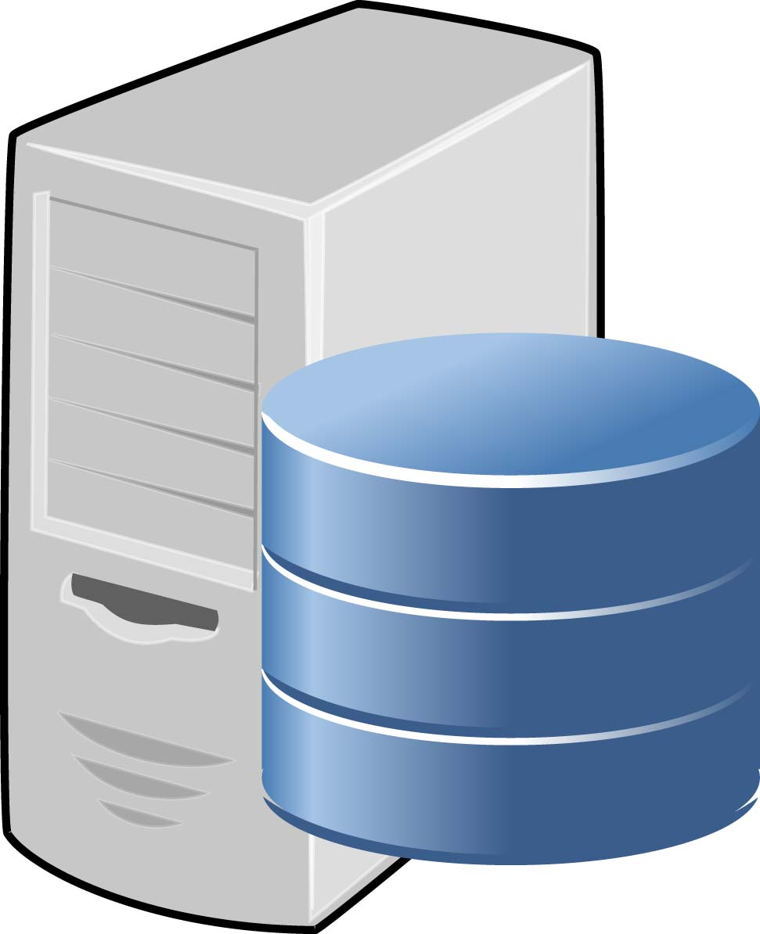
What is Oracle?
It is a full-fledged database development environment
It consists of a suite of products. These products allowed us to design and create databases and associated applications
At the core of the oracle product, is the Oracle Server.
Server
DB

Slide 4

What is the Oracle Server?
Oracle Server: It is an object-relations database management system that consists of Oracle Server Instance and Oracle Database

Slide 5

Database Management System(DBMS):
A DBMS should be capable of must reliably managing a large amount of data in a multi-user environment so that many users can concurrently access the same data without compromising the integrity of the data.
Should provide security
Should provide recovery mechanism

Slide 6
Overview of Primary Components of Oracle
Instance
User
Process
Shared Pool
SGA
Library Cache
Database Buffer Cache
Redo Log Buffer
Server
Process
Data Dictionary Cache
PGA
Java Pool
Large Pool
PMON
SMON
DBWR
LGWR
CKPT
Others
Database
Parameter
File
Data
Files
Control
Files
Redo Log
Files
Archived
Log Files
Password
Files

Slide 7
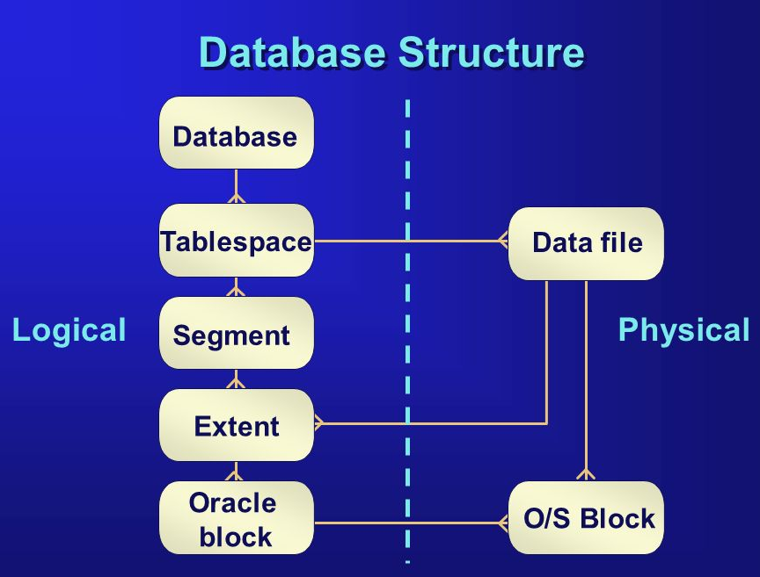
What is a Server Instance?
It is basically a copy of the Oracle Software running on a particular server with associated tablespaces
Tablespaces: A database is divided into logical storage units called tablespaces, which group related logical structures together.

Slide 8
Establishing Connections
The user starts a tool or an application(such as SQL *Plus). The application or tool is executed as a user process.
When a user logs on to the Oracle server, a process is created on the computer running the Oracle server. This process is called a server process.
Now we can submit SQL statements to an Oracle database
Whenever the user submits SQL statements, the server process will receive & execute SQL statements on behalf of the user.

Slide 9
Database
Databases logically appear as services, you identify each database in your system by its service name.
The database instance name refers to the SGA and processes that make up the instance, this is commonly referred as the Oracle System Identifier (SID), normally a database is only associated with one instance.
You can uniquely identify each database by using a global database name which is in the format of database_name.database_domain.
Example: sales.us.acme.com

Slide 10
Connection
You need two pieces of information to connect to a database
Name of the database server - name of the service that oracle is supplying
Location of the address - need to supply the protocol type (default TCP) , hostname and the port number (default 1521)

Slide 11
Listener
Oracle listener only runs on the server and listens for incoming client connections.
Its role:
The database registers information about the services, instances and service handlers with the listener
The client makes the initial connection with the listener
The listener receives and verifies the connection and forwards it to the service handler, once the listener hands off the request, the listener is out of the picture

Slide 12
Dedicated Connection
Oracle will create a new process when you log on, this is commonly know as the dedicated server process, the process will exists as long as the connection exists.
For every session a new dedicated server process will be created.
Its functions:
This process will receive SQL and execute it, read data files and look in the database cache for data.
It will also perform update statements and run any PL/SQL code.

Slide 13
Establishing a Connection & Creating a Session
1. To establish connection
Listener
User
Process
x
When valid, Listener hands over connection to a created server process & its out of the picture
Submit Queries
2. Connection Established
Server
Process
Session Established
Oracle Instance
Oracle Server
Oracle Database

Slide 14
Process Architecture
A process is a "thread of control" or a mechanism in an operating system that can run a series of steps. Some operating systems use the terms job or task.
A process generally has its own private memory area in which it runs.
An Oracle server has two general types of processes:
User processes: client-side application which manages communication with the server process through the program interface
Oracle processes: are of two types Server Process and Background processes

Slide 15
Oracle Processes
Server Processes: Oracle creates server processes to handle requests from connected user processes. A server process communicates with the user process and interacts with Oracle to carry out requests from the associated user process.
Background Processes: Oracle creates a set of background processes for each instance.
To maximize performance and accommodate many users, a multi-process Oracle system uses some additional Oracle processes called background processes.
An Oracle instance can have many background processes; not all are always present. Each Oracle instance can use several background processes. The names of these processes are DBWn, LGWR, CKPT, SMON, PMON, & ARCn,etc.

Slide 16
Non-database Files
Parameter file:
is used to define the characteristics of an Oracle instance. When the Oracle server starts up an instance, the server uses the parameter file to get the instance configuration.
specifies the name of the database, the amount of memory to allocate, the names of control files, and other system parameters.
In most cases the database will not start without a parameter file.
Password File
The password file is used to authenticate or validate the privileged database users.
Archived Redo Log File:
stores offline copies of the redo log files, which are used during recovery of a system failure.

Slide 17
Database Files
Three types of files that exist in a database are :
Data Files: contain the actual data in the database.
Redo Log Files: contain a record of changes made to the database to enable recovery of the data in case of failures.
Control Files: contain information necessary to maintain and verify database integrity. These files store the physical database structure information, such as the database name, the timestamp of the database creation, and the names and location of the data files and online redo log files.

Slide 18
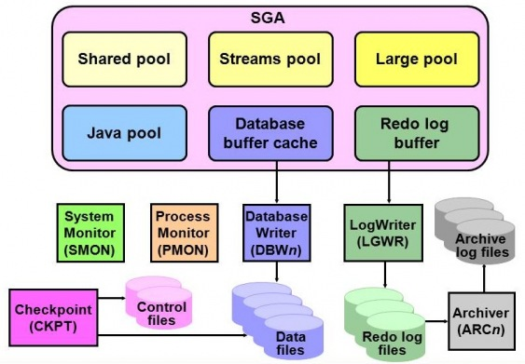
Background Processes

Slide 19
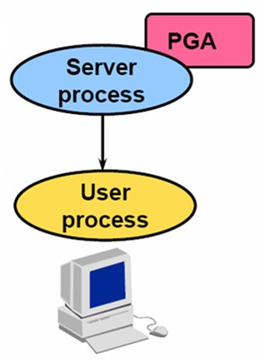
PGA
The Program Global Area (PGA) is a memory buffer that contains data and control information for a server process.
A PGA is created by Oracle when a server process is started.
The information in a PGA depends on the Oracle configuration.

Slide 20
SGA
The System Global Area (SGA) is a shared memory region that contains data and control information for one Oracle instance. Oracle allocates the SGA when an instance starts and de-allocates it when the instance shuts down. Each instance has its own SGA.
The three main memory structures are:
Shared Pool
Database Buffer Cache
Redo Log Buffer
There are two additional memory structures that can be configured within the SGA: Large Pool & Java Pool
You can view the SGA memory allocations by using the SHOW SGA command

Slide 21
Shared Pool
The shared pool is used to store information such as:
The most recently executed SQL statements.
The most recently used data definitions.
It consists of two key performance-related memory structures:
Library Cache - stores information about the most recently executed SQL statements. In Oracle 9i, the Shared Pool can be dynamically resized to grow or shrink by using the ALTER SYSTEM SET SHARED POOL command.
Data Dictionary Cache is also referred to as the Row Cache. It consists of a collection of the most recently used definitions in the database.
Shared Pool
Library Cache
Data Dictionary Cache

Slide 22
Database Buffer Cache
The database buffer cache stores copies of data blocks that have been retrieved from the data files.
When a query is processed, the Oracle server process looks in the Database buffer cache for any blocks it needs.
If the block is not found in this buffer cache, the server process reads the block from the data-file and places a copy in the Database Buffer Cache.

Slide 23
Redo Log Buffer
The Redo Log Buffer is used to record all changes made to the data during DML statement processing.
Its primary purpose is data recovery.
The changes made within are called Redo Log Entries.

Slide 24
Additional Memory Structures
Large Pool
An optional area of memory in the SGA.
Relieves the burden placed on the Shared Pool.
Java Pool
The Java Pool is an optional setting but is required if we are installing and using Java.
In Oracle 9i, the default size of the Java Pool is 24 MB.

Slide 25
Background Processes
Five(5) mandatory process:
Database Writer (DBWn): writes only modified data blocks from the database buffer cache to the data files.
Log Writer (LGWR): records the changes that are registered in the Redo Log Buffer to the Redo Log Files.
System Monitor (SMON): If the Oracle instance fails, any information in the SGA that has not been written to disk is lost. After the loss of the instance, SMON automatically performs instance recovery when the database is reopened.
Process Monitor (PMON): The PMON process performs process recovery when a user process fails.
Checkpoint (CKPT): Signals DBWn at checkpoints and updates all the data files and control files of the database to indicate the most recent checkpoint

Slide 26


